Slide 1



Forecasting the pharmacy medicines and optimizing the inventory levels

Slide 2

Project Leadership
Bharani Kumar Depuru
Director & Co-Founder at Innodatatics | Chief Data Scientist
https://www.linkedin.com/in/bharanikumardepuru/

Slide 3

Team Members
Ripan Debnath
Team Member
linkedin.com/in/ripan-debnath-9080bb123

Slide 4

Contents
Introduction
Project Goals
CRISP-ML(Q) Methodology
Technical Stacks
Project Architecture
Data Collection
Exploratory Data Analysis [EDA]
Model Building
Model Deployment
Screen shot of output
Challenges
Future Scopes
Notes:
Change

Slide 5
Project Overview and Scope
The objective is to build a forecasting model for reduction of shortages of drug Quantity supply in pharmaceutical industry.
Business Constraint: Maximize the availability of stocks
Business Objective: Minimize the shortage of drugs

Slide 6
Project Goals
Build the forecasting model for quantity of drug.
Maximize the medicine stocks.

Slide 7
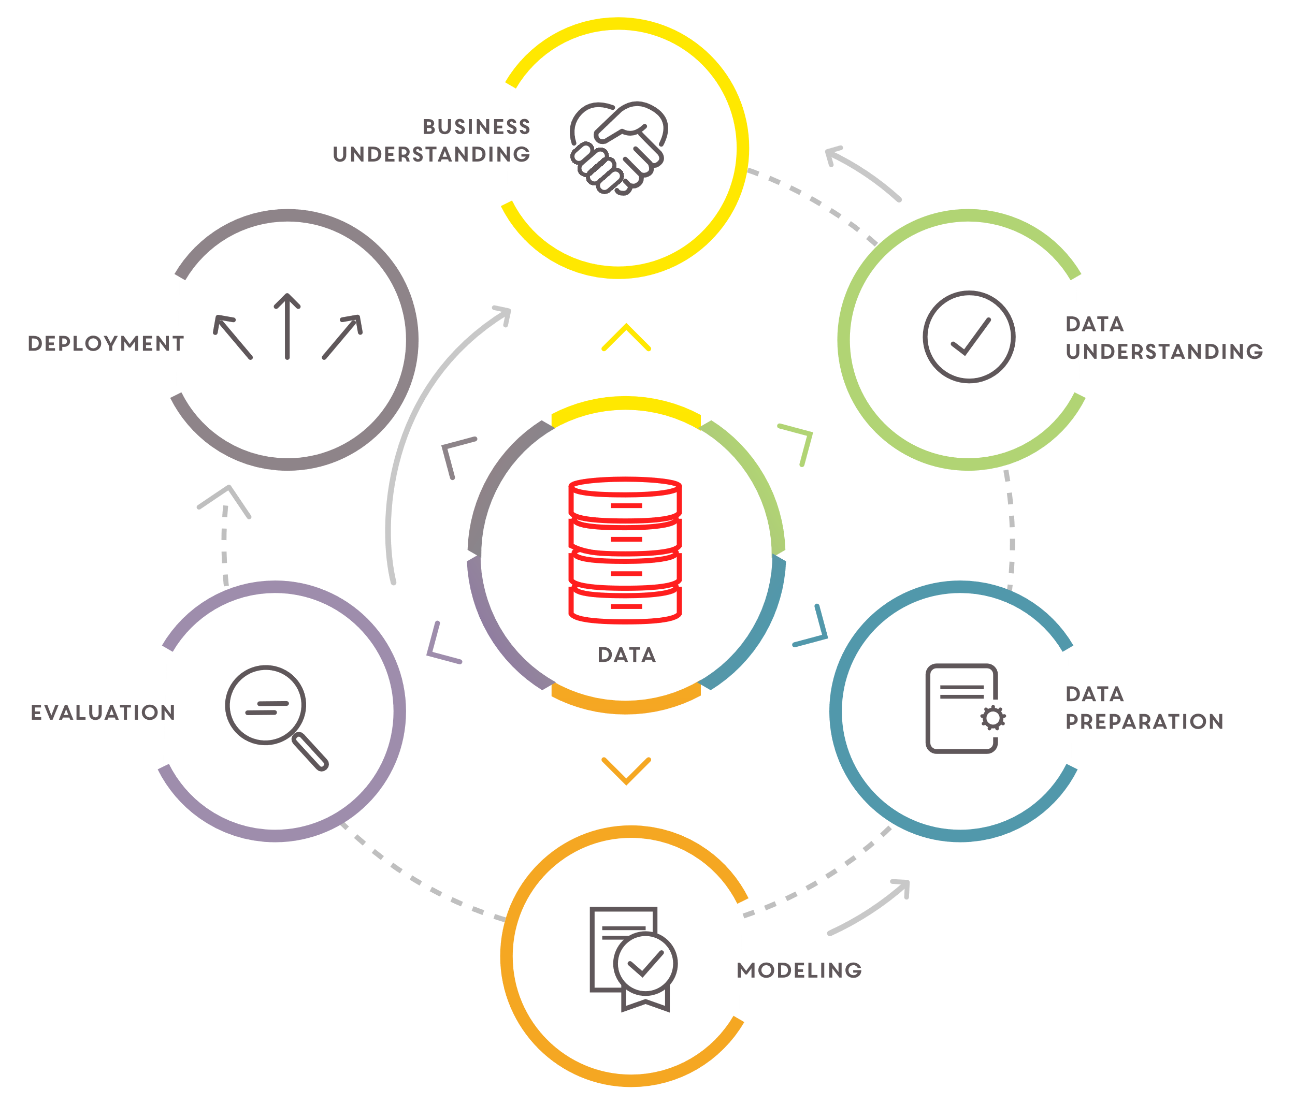
CRISP-ML(Q) Methodology

Slide 8










Technical Stacks
Notes:
Pycharm add Tableau

Slide 9







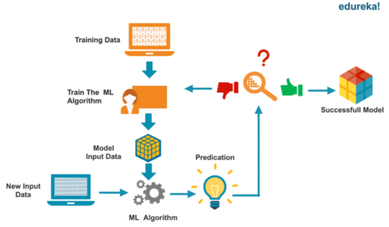
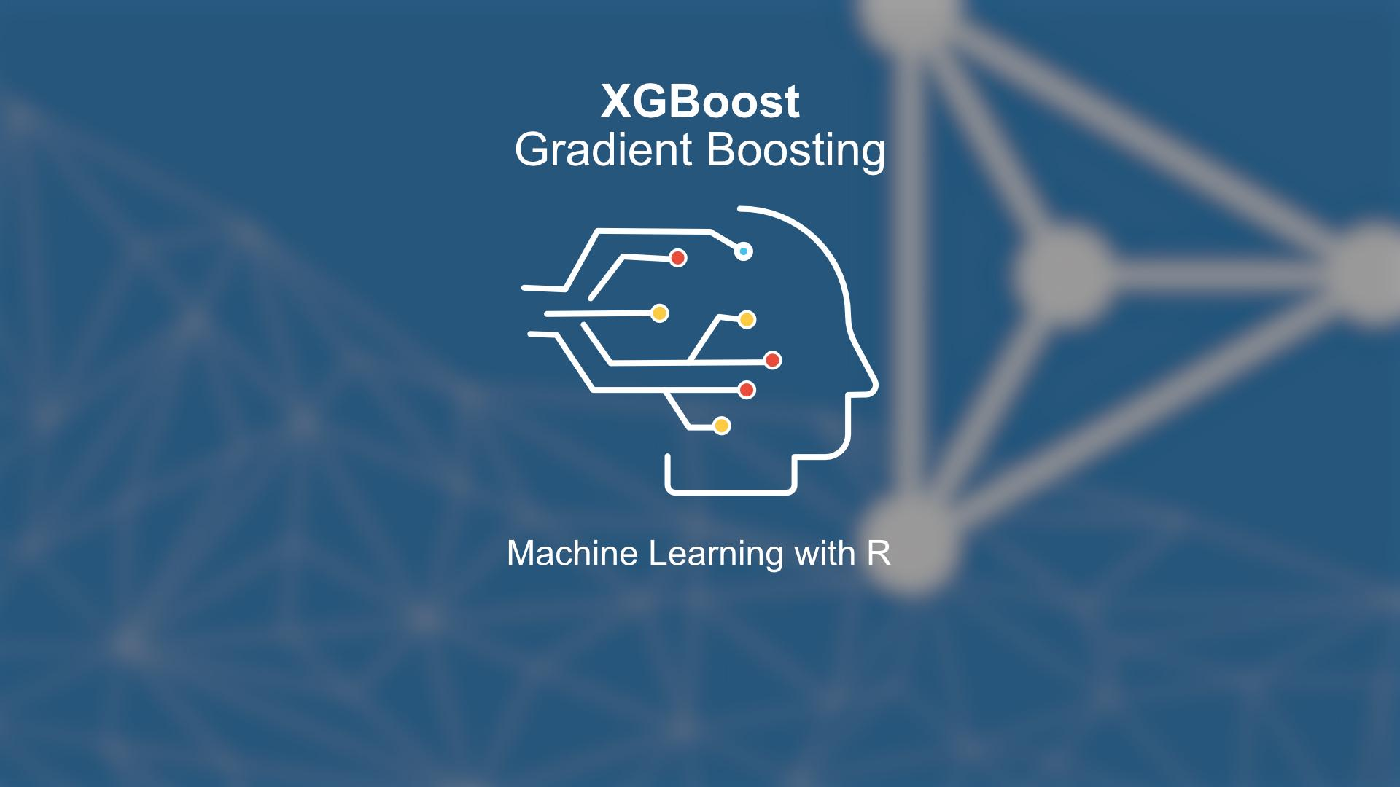
Project Architecture
Data Understanding and Data Pre-processing
Feature Engineering
Model Building

Slide 10

Data Collection
Data Collection is defined as the procedure of collecting, measuring and analyzing accurate insights for research using standard validation techniques.
Data collection :
Primary Data Sources : Data collected via survey
Secondary Data Sources : Data collected from client server.

Slide 11

Data Information
In this model the data is analyzed considering the below features for the model building.
 | Data Dictionary
Sr.no | Name of the features | Description | Data Type
1. | Typeofsales | Type of the sales | Categorical(Binary)
2. | Specialization | Specialization of the doctor | Nominal
3. | Dept | Dept of the drug | Nominal
4. | Dateofbill |  | Time-Series Data
5. | Quantity | Quantity of the drugs | Numeric
6. | ReturnQuantity | Return Quantity of the drugs | Numeric
7. | Final_Cost | Final cost of the drugs | Continuous

Slide 12
Data Information
In this model the data is analyzed considering the below features for the model building.
 | Data Dictionary
Sr.no | Name of the features | Description | Data Type
8. | Final_Sales | Final Sales of the drug | Continuous
9. | DrugName | Name of the drug | Discrete
11. | SubCat | Sub category of the drug | Discrete

Slide 13

System Requirements
System Requirements
Memory: 4GB RAM
CPU: Intel Core i3 11th Gen
OS: Windows 11
Prepare Environment
Install python version 3.10.8
Install Anaconda software to launch IDE platform like Jupyter
Creating a new Environment
Install Pandas for preprocessing of data
Install NumPy for mathematical calculations
Install sklearn
Install Streamlit for web-frame work

Slide 14
EDA Description
Treating missing values
Handle with duplicate values
Removing unwanted columns
Check for variance columns
Treating with outliers
Convert the “Date” column into Time series format
Calculate the total quantity of drug by date
Check where data normally distributed or not

Slide 15
Time series description
Time Series Decomposition: A time series is usually composed of the following components:
1) Trend : This component usually is increasing, decreasing, or constant.
2) Seasonality : This is the periodic behavior of the time series that occurs within a year.
3) Residual : This is what remains of the time series after the trend and seasonality are removed.
The basic approach to seasonal decomposition splits the time series into above components.

Slide 16
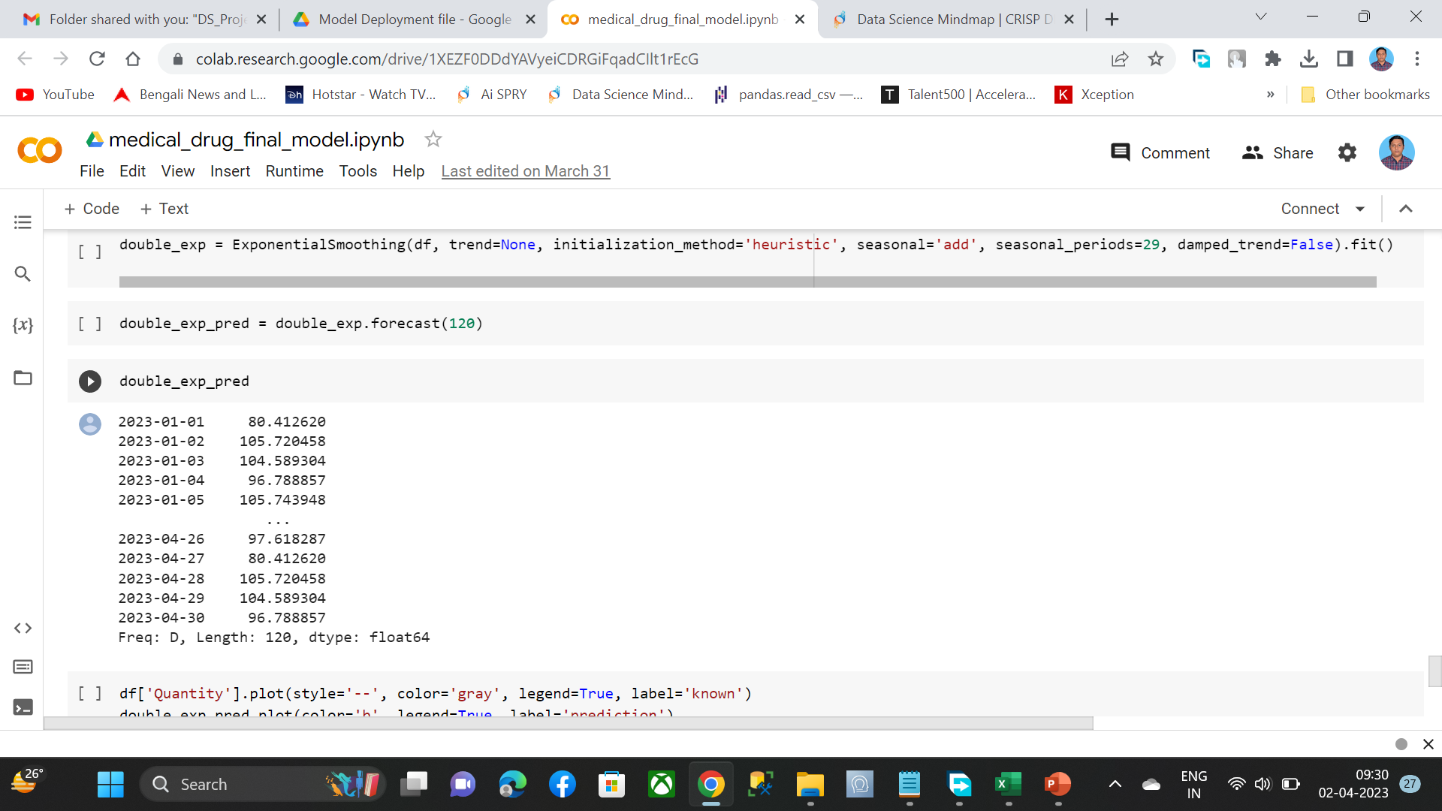
Model Building
Notes:
classification is the task of predicting a discrete class label. Regression is the task of predicting a continuous quantity.
What is classification techniques in machine learning?
The Classification algorithm is a Supervised Learning technique that is used to identify the category of new observations on the basis of training data. In Classification, a program learns from the given dataset or observations and then classifies new observation into several classes or groups.
What is regression techniques in machine learning?
Regression is a technique for investigating the relationship between independent variables or features and a dependent variable or outcome. It's used as a method for predictive modeling in machine learning, in which an algorithm is used to predict continuous outcomes.

Slide 17
Model Building
Stationary Time Series : A stationary time series is one whose statistical properties such as mean, variance, autocorrelation, etc. are all constant over time. Most statistical forecasting methods are based on the assumption that the time series can be rendered approximately stationary (i.e., "stationarized") through the use of mathematical transformations. A stationarized series is relatively easy to predict
Sign of obvious trends, seasonality, or other systematic structures in the series are indicators of a non-stationary series. A more accurate method would be to use a statistical test, such as the Dickey-Fuller test.
ADFuller Test: If Test statistic < Critical Value and p-value < 0.05 – then series is stationary

Slide 18
Model Description
Observation :
The p-value obtained is less than significance level of 0.05 and the ADF statistic is less than any of the critical values. Hence the series is stationary
Autocorrelation and Partial Autocorrelation Function: Autocorrelation and partial autocorrelation are plots that graphically summarize the impact of observations at prior timesteps on the observations we are trying to predict.
ACF plot gives the q value and PACF gives the p value Look for tail of pattern in either ACF or PACF. If tail is crossing the blue region then it will give us potential p and q values.

Slide 19
Model Building
Observation :
The p-value obtained is less than significance level of 0.05 and the ADF statistic is less than any of the critical values. Hence the series is stationary
Autocorrelation and Partial Autocorrelation Function: Autocorrelation and partial autocorrelation are plots that graphically summarize the impact of observations at prior timesteps on the observations we are trying to predict.
ACF plot gives the q value and PACF gives the p value Look for tail of pattern in either ACF or PACF. If tail is crossing the blue region then it will give us potential p and q values.

Slide 20
Model Building
Exponential Smoothing: Exponential smoothing is a time series forecasting method for univariate data. There are three main types of exponential smoothing time series forecasting methods. A simple method that assumes no systematic structure, an extension that explicitly handles trends, and the most advanced approach that add support for seasonality.
Single Exponential Smoothing
Single Exponential Smoothing Single Exponential Smoothing, SES for short, also called Simple Exponential Smoothing, is a time series forecasting method for univariate data without a trend or seasonality.

Slide 21
Model Building
Double Exponential Smoothing Double Exponential Smoothing is an extension to Exponential Smoothing that explicitly adds support for trends in the univariate time series
Triple Exponential Smoothing Triple Exponential Smoothing is an extension of Exponential Smoothing that explicitly adds support for seasonality to the univariate time series. Also known as Holt-Winters Exponential Smoothing.
ARIMA A popular and widely used statistical method for time series forecasting is the ARIMA model. ARIMA is an acronym that stands for AutoRegressive Integrated Moving Average. The parameters of the ARIMA model are defined as follows:
p : The number of lag observations included in the model, also called the lag order. d : The number of times that the raw observations are differenced, also called the degree of differencing. q : The size of the moving average window, also called the order of moving average.

Slide 22
Model Building
Auto ARIMA:
Although ARIMA is a very powerful model for forecasting time series data, the data preparation and parameter tuning processes end up being really time consuming. Before implementing ARIMA, you need to make the series stationary, and determine the values of p and q using the plots we discussed above. Auto ARIMA makes this task really simple for us as it eliminates many steps
Prophet
Prophet The Prophet library is an open-source library designed for making forecasts for univariate time series datasets. It is easy to use and designed to automatically find a good set of hyperparameters for the model in an effort to make skillful forecasts for data with trends and seasonal structure by default.
The DataFrame must have a specific format. The first column must have the name ‘ds‘ and contain the date-times. The second column must have the name ‘y‘ and contain the observation

Slide 23
Model Evaluation
Model | RMSE | MAPE
double exp smoothing | 46.050 | 0.34
Triple exp smoothing | 42.070 | 0.34
ARIMA(15,1,15) | 42.071 | 0.36
ARIMA(16,1,16) | 42.070 | 0.36
Single exp smoothing | 41.890 | 0.37

Slide 24



Model Deployment - Strategy
Web based deployment was used to deploy code from source control to hosting platform.
Streamlit and Streamlit-Cloud was used for web-framework app and deployment.
Heroku connects with GitHub to make it easy to deploy code living on GitHub to apps running on Streamlit.
Create a GitHub repository containing all the required files ( installation requirements, text files) etc.
Created an app using Streamlit framework..

Slide 25
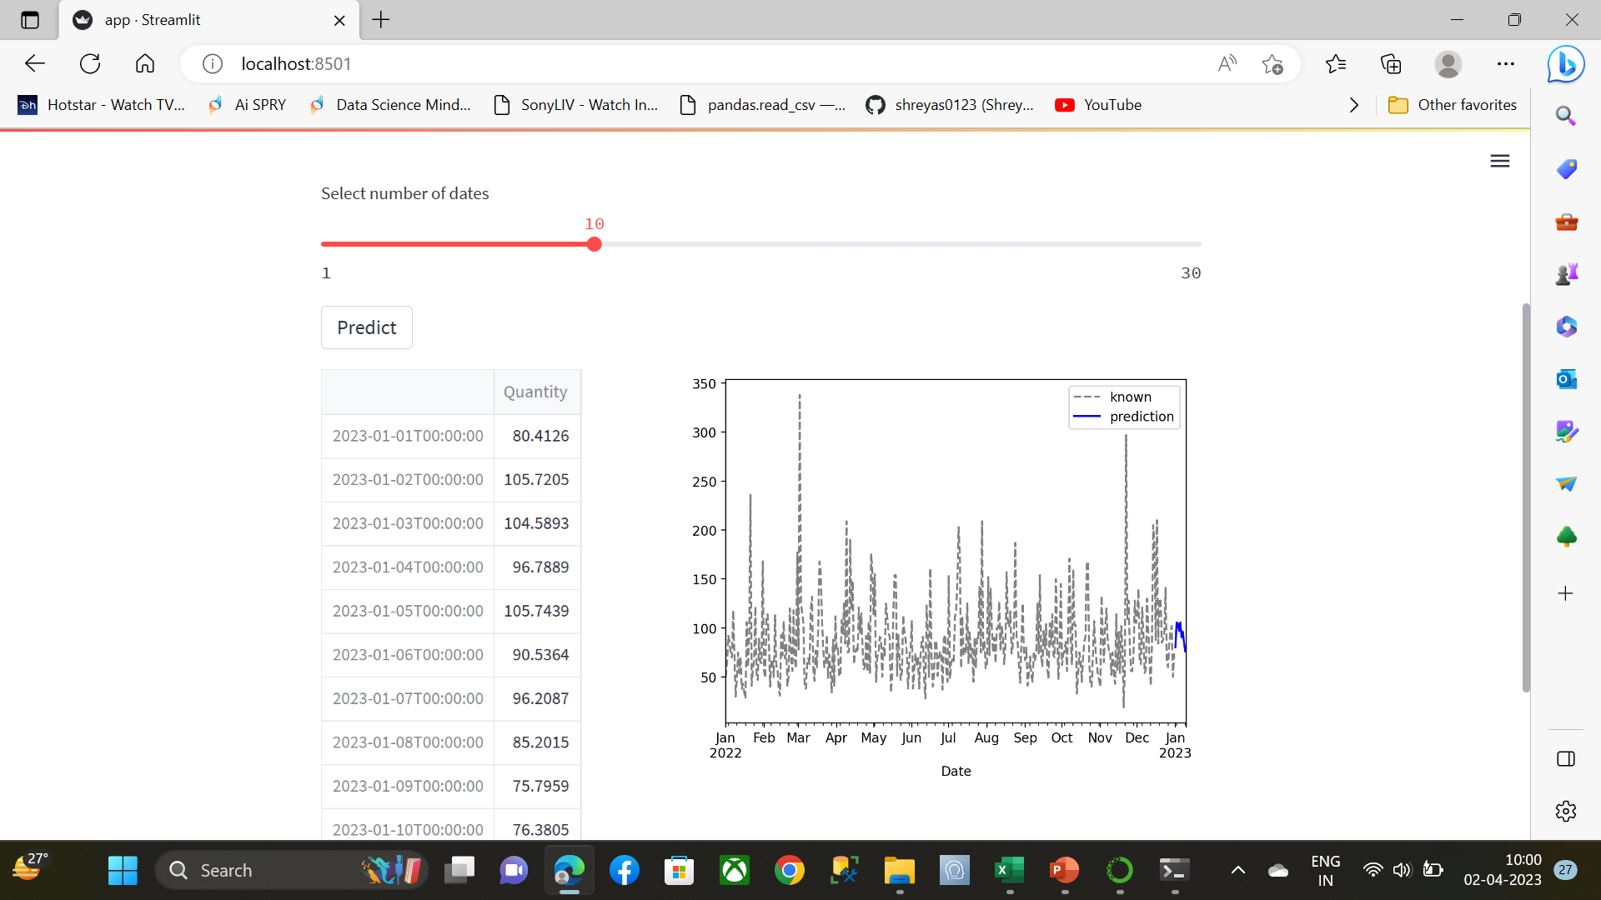
Screen shot of output - Streamlit

Slide 26
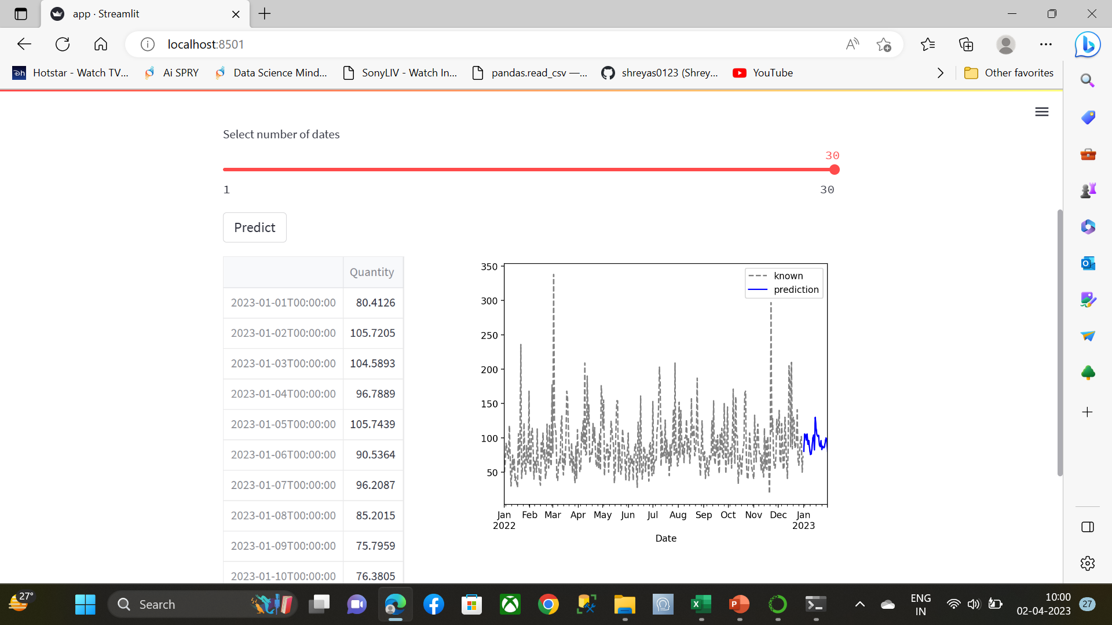
Screen shot of output

Slide 27

Challenges
First challenge was collection of dataset.
Choosing the right set of features required to set the model.
Deploying the model streamlit.

Slide 28

Future Scope
Features updation according to the new items.
Measuring the success rate of the app.
Data collection through other online sources.
This model can be used for existing app’s also.
45

Slide 29

Queries ?

Slide 30


